Slide 1
STONECrew Parent Meeting
We need you…and your children.

Slide 2
This ministry is designed to develop and deploy students to make disciples for life God’s way.
Method: Integrated Discipleship

Slide 3
Integrated Discipleship Strategy
Weekly/monthly activities
Social media engagement
Corporate worship and discipleship

Slide 4
Monthly Activities
November | Friendsgiving | Wednesday the 17th
December | Christmas Party | Wednesday the 15th
January | Mission Arlington | Monday the 17th
February | Date Night/Paint Party | Wednesday the 16th
March | Lock-In? | TBD
April | Mission Arlington | Saturday the 23rd
May | Formal | TBD
June | Summer Kickoff/BBQ | Saturday the 18th
July | TBD | TBD
August | Back 2 School Party | Saturday the 20th
September | Mission Arlington | Saturday the 24th
October | TBD | TBD

Slide 5
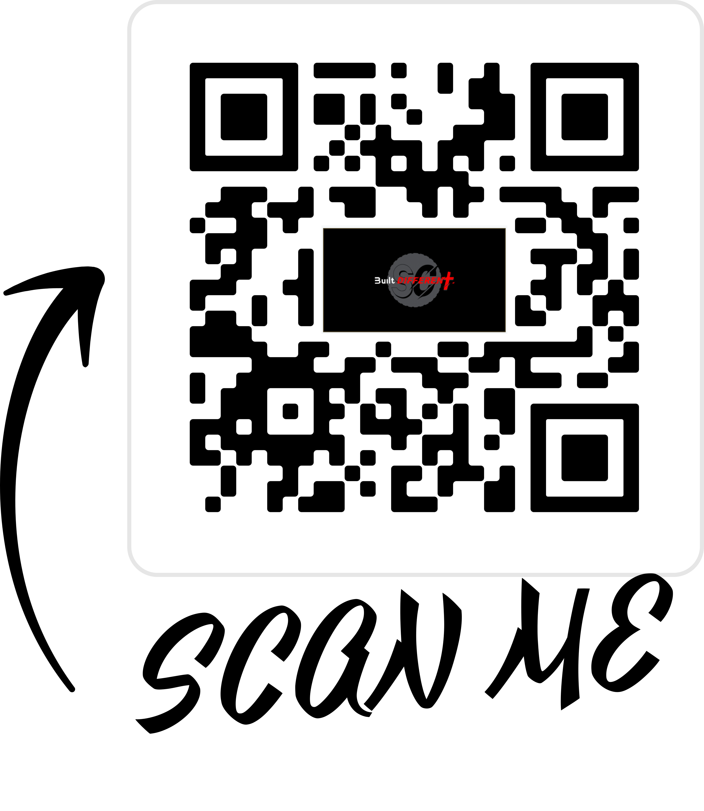
Social media engagement

Slide 6
5 Learning Styles
Auditory
Visual
Written
Kinesthetic - movement
Multimodal – multiple styles
We are being innovative currently in our Wednesday Night sessions.
We are seeking to integrate different leading styles and also different age groups.

Slide 7
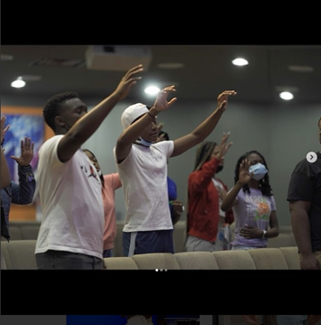
Autonomous Student-led Worship
Sunday, January 30th at 10am.
Encourage your children to come and invite their friends!!

Slide 8
What we need from YOU
All youth signed up for TextInChurch – text “youth” to 817.468.0083
Follow our Instagram page @stonecrewyouth
All youth in Sunday School and Bible Study
All youth signed up for a ministry serving the church (parking team, media, worship, connection, etc.)
Promote the student ministry
Email us with questions and concerns – stoneyouth@cbcarlington.org

